Slide 1
Exploring git and git branching models
Jacob Archambault
Associate software developer, Pet Partners

Slide 2
1 How git works

Slide 3
1.1 What git is
‘Git is a free and open-source distributed version control system designed to handle everything from small to very large projects with speed and efficiency’ – https://git-scm.com

Slide 4
1.1.1 Git is version control
Version control – a system for managing distinct states, or versions, of a project, typically used to coordinate its development across multiple authors and track that development over time.
Other version control systems:
Subversion (SVN)
Mercurial
Perforce
CVS

Slide 5
1.1.2 Version control goals
Provides developers with shared base to work from
Separates in-progress from completed work
Allows for clear versioning of successive releases
Allows critical bugs to be fixed quickly

Slide 6
1.1.3 Git is distributed
Centralized version control system
Distributed version control system
Client-server model
Examples: CVS, SVN, Perforce
Advantages
Less complex
Disadvantages
Saving requires internet connection
Model-agnostic
Examples: Git, Mercurial
Advantages
Increased redundancy
More powerful and expressive
Disadvantages
Increased moral hazard
Increased codebase exposure

Slide 7

2 Git Flow

Slide 8
2.1.1 Git Flow: permanent branches
Branch type | Purpose
Develop | Represents an agreed upon, shared base state from which developers create new features
Master | Represents the state of an application’s most recent production release

Slide 9
2.1.2 Git Flow: transient branches
Branch type | Source | Targets | Purpose
Feature | develop | develop | New feature development
Release | develop | master & develop | Releasing new features to staging, then production environments
Hotfix | master | master & develop | Fixing high-priority errors in production
Defect | Release | Release | Fixing errors in staging

Slide 10
2.1.3 Problems Git Flow solves
Provides developers with shared base to work from
Separates in-progress from completed work
Allows for clear versioning of successive releases
Allows critical bugs to be fixed quickly

Slide 11
2.2.1 Git Flow: essential problems
Late merging of bugfixes and feature work
Staging doesn’t accurately mirror production
Late, bundled releases of features to QA
QA has too little to do during first week, too much during the second.
Excessive branch coordination
Greater risk of accidents
E.g. Incorrect versioning, premature merging, merging to wrong branch
Increased moral hazard
E.g. Breaking commits, abandoned branches, non-working develop
Finish functionality conflicts with implementing branching policies

Slide 12
2.2.2 Git Flow: auxiliary problems
Perfunctory code reviews (esp. on release days) that fail to prevent bugs.
DevOps tech: Trunk-based development | Google Cloud
Alternate solution: hop on call, do a demo
Code freezes
non-critical improvements are less likely to be implemented for Monday PRs.

Slide 13
2.2.3 Git Flow auxiliary problems: Fork
Fork masks branch model complexity and forces reliance on GUIs for at least some of our Git interactions.
Fork introduces tooling redundancy and undermines full development environment integration.
Some necessary functionality isn’t automated (i.e. hotfixes into release branches)
Fork isn’t free.

Slide 14
3 Git branching models

Slide 15
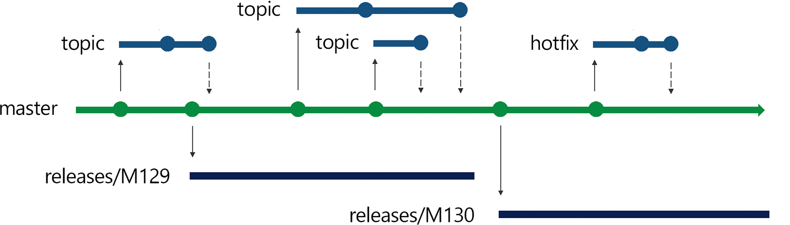
3.1 Release Flow

Slide 16
3.1.1 Release Flow: Permanent branches
Branch type | Purpose
Master | Represents an agreed upon, shared base state from which developers create new features
Release branches | Represents the state of a particular release

Slide 17
3.1.2 Release Flow: transient branches
Branch type | Source | Targets | Purpose
Feature | Master | Master | New feature development

Slide 18
3.1.3 Problems Release Flow solves
Goal | Release flow
Shared developer base | Master branch
Separating in-progress work | Feature branches
Clear versioning | Release branches
Quick bug fixes | Cherry picking from master to release branch

Slide 19
3.1.4 Release Flow: pros
Very similar to Git Flow
Achieves everything Git Flow does with less branch complexity
Staging accurately mirrors production
Hotfixes are merged into shared dev base immediately
Room for branch policies
Integrated development environment

Slide 20
3.1.5 Release flow: cons
Delivery isn’t continuous
Late, bundled releases of features to QA
Potential for code review bottlenecks
Code freezes
Room for error with cherry picking

Slide 21
3.2.1 GitHub Flow: permanent branches
Branch type | Purpose
Master | Represents an agreed upon, shared base state from which developers create new features

Slide 22
3.2.2 GitHub Flow: transient branches
Branch type | Source | Targets | Purpose
Feature | Master | Master | New feature development; Deployments

Slide 23
3.2.3 Problems GitHub Flow solves
Goal | Release flow
Shared developer base | Master branch
Separating in-progress work | Feature branches
Clear versioning | Tags, artifacts [optional]
Quick bug fixes | Fixes roll forward

Slide 24
3.2.4 GitHub Flow: pros
Simple branching model
Made for continuous deployment
Immediate release of features to QA
Short or no code freezes
Same artifact can be released to staging, then production
Integrated work environment

Slide 25
3.3.5 GitHub Flow: cons
Requires greater discipline and coordination
Shorter branches
Keep local master up-to-date
rebasing
Potential for code review bottlenecks
Requires ability to handle frequent deployments

Slide 26
3.4.1 Trunk-based development: permanent branches
Branch type | Purpose
Master | Represents an agreed upon, shared base state from which developers create new features

Slide 27
3.4.2 Trunk-based development: transient branches
Branch type | Source | Targets | Purpose
Release | Master | Master | Releasing features into staging/production environments

Slide 28
3.4.3 Problems Trunk-based development solves
Goal | Release flow
Shared developer base | Master branch
Separating in-progress work | Local branches
Clear versioning | Tags, artifacts
Quick bug fixes | Fixes roll forward

Slide 29
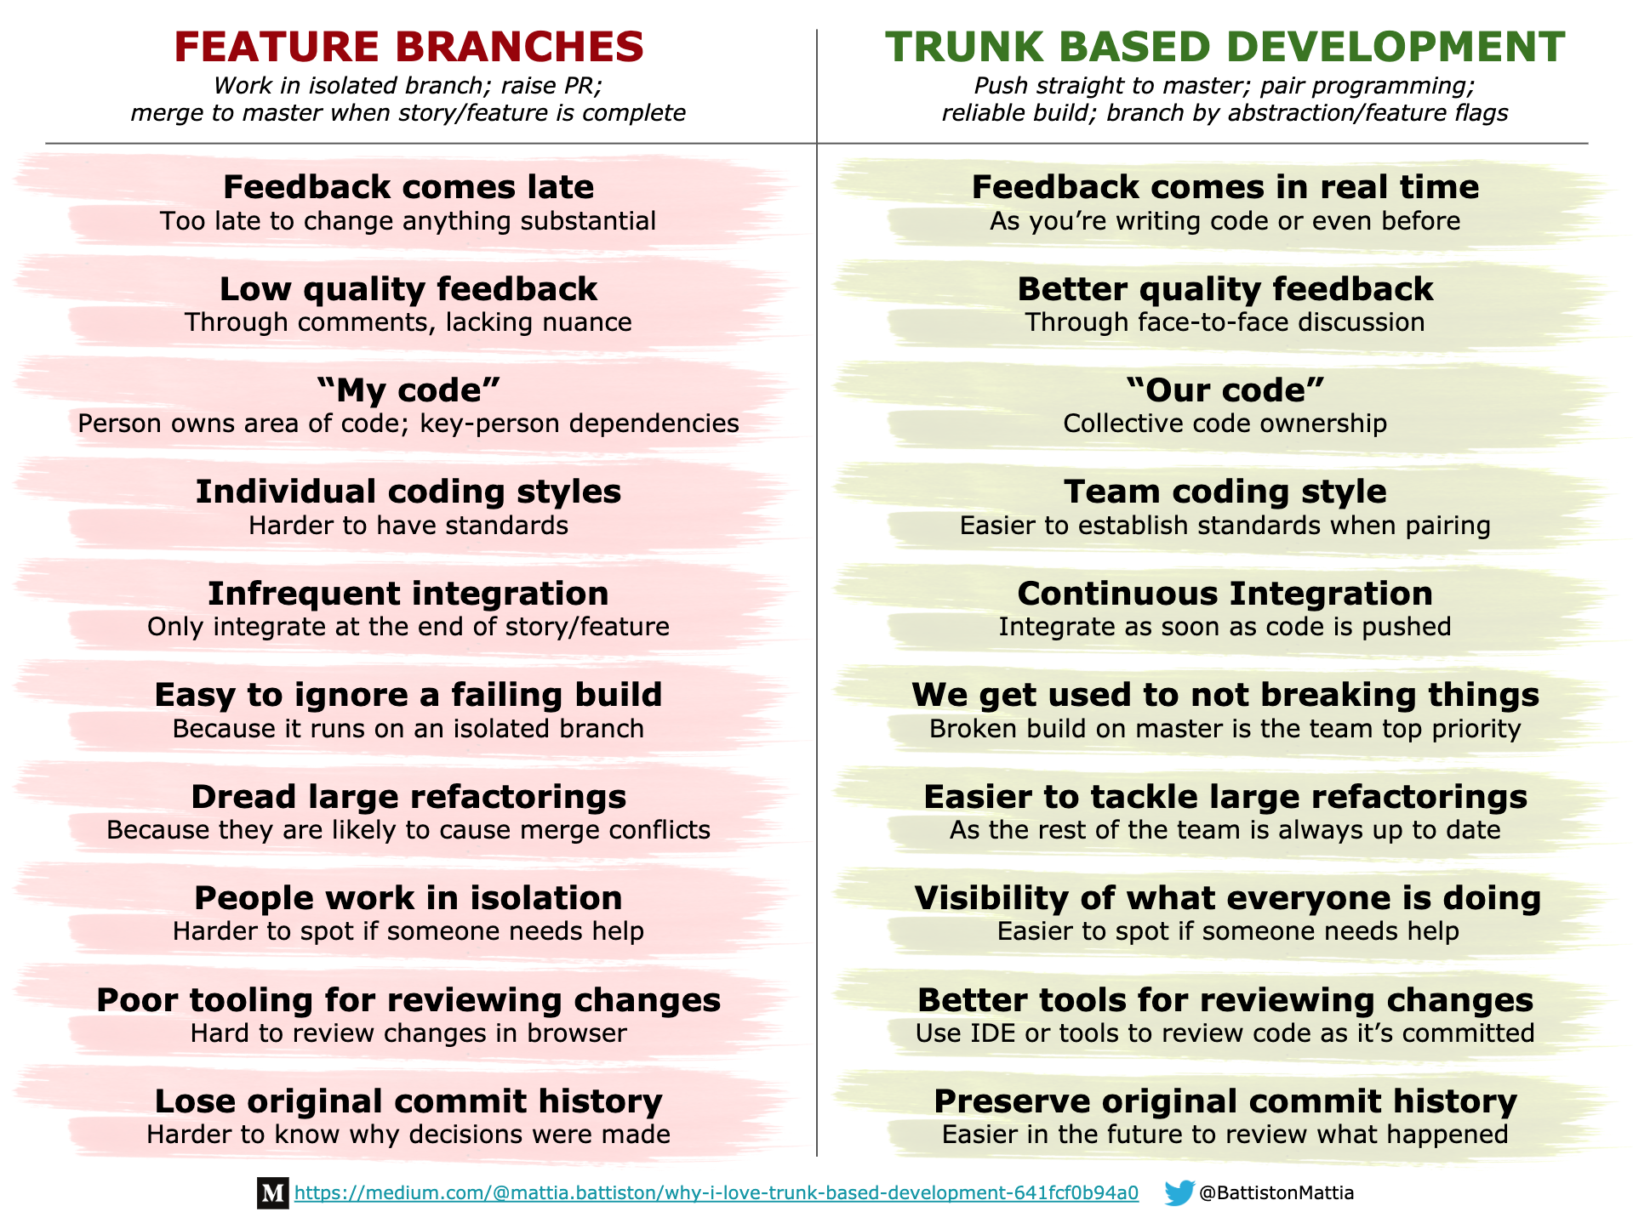

Slide 30
3.4.4 Trunk based development: pros
Simplest branching model
Breaking changes spotted immediately
Code should be deployable anytime
Continuous integration; high level of developer coordination
Made for continuous deployment
Immediate release of features to QA
No code freezes
Same artifact can be released to staging, then production

Slide 31
3.4.5 GitHub Flow: cons
Requires greater discipline
Highly dependent on automation for checks
Dovetails with Test-driven development

Slide 32
4 Conclusion

Slide 33
4.1 Conclusion
Version control goals
Provides developers with shared base to work from
Separates in-progress from completed work
Allows for clear versioning of successive releases
Allows critical bugs to be fixed quickly
As with centralized vs. decentralized version control systems, the main tradeoffs between different branching models are between
Simplicity vs expressiveness
Increased exposure vs increased moral hazard
Human error vs merge errors
Visibility vs autonomy

Slide 34
4.2 Conclusion
By design, Git Flow essentially requires
disparities between staging and production environments, or
disparities between master and develop, or
excess branch coordination which increases user error
Release flow achieves what Git Flow does with less branch complexity
GitHub flow simplifies branching by combining feature and deployments, aiming for more frequent deployments
Trunk-based development involves pushing straight to master. It relies on automation for review and assumes increased integration and visibility offsets the dangers involved in developer error.

Slide 35
5 Questions

Slide 36
Appendix: Git commits and directed acyclic graphs

Slide 37
1 How git saves work
VCS before git
Git
as changesets
at file level
as snapshots
at repository level

Slide 38
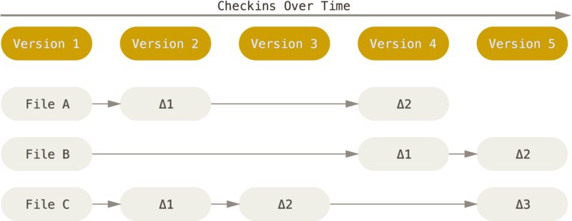
2 VCS before git

Slide 39
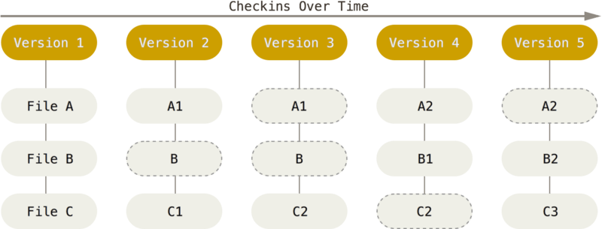
3 Git VCS

Slide 40

4 Git changes and directed acyclic graphs
Graph - $G=(V, E)$
$V$ – a set of elements, called vertices.
$E$ – a set of pairs of members of V.
Directed graph - $E⊆\{\left(x,y\right)|∈V^{2} and x≠y\}$
Acyclic graph - $∀x,y(Exy →¬∃z_{1…n}(Eyz_{1}…\& Ez_{n−1}z_{n} \& Ez_{n}x)$
E.g. a family tree

Slide 41
